Slide 1
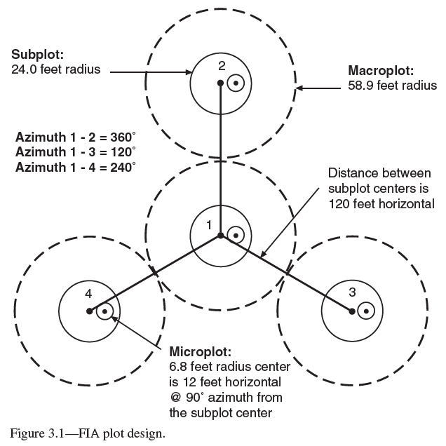
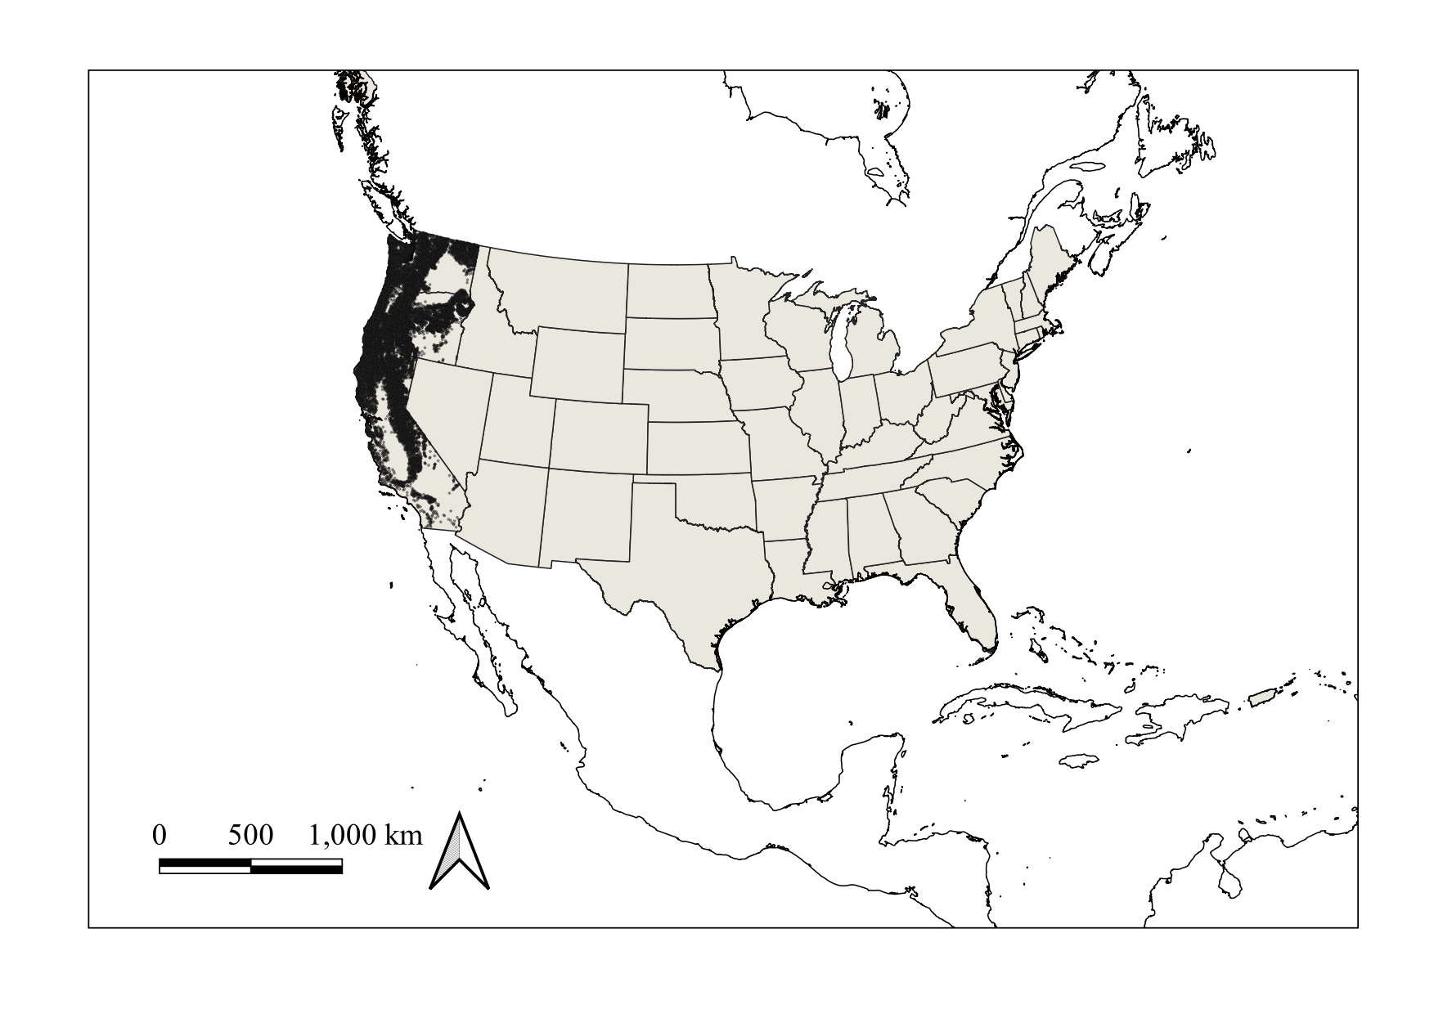


Are tree species’ ranges shifting in west coast USA states? J.D. Groom¹, M.J. Vicente²
Situation:
Climate change may be geographically shifting tree species’ niches.
Tree species may adjust their ranges along elevational and/or latitudinal gradients in mountainous regions through mortality and recruitment.
Changes in temperature and precipitation may drive geographic niche shifts.
Are tree species shifting their ranges according to changes in temperature and precipitation?
Are their densities shifting within their ranges?
How are temperature and precipitation changing within species’ ranges?
Opportunity and methods:
The U.S. Forest Service Forest Inventory and Analysis (FIA) program completed revisiting plots in California, Washington, and Oregon. Ten years passed between plot visits.
This represents a chance to directly measure plot changes between visits.
Range shift = change in occupancy patterns between visits.
Density shift = difference between plots that gained and lost trees.
Temperature, Precipitation: obtained from PRISM (Parameter-elevation Regressions on Independent slopes Model, Daly et al. 2008)
FIA plot design for a single plot. Figure 3.1, Bechtold and Scott 2005
15,390
plots
¹Groom Analytics, LLC. Corvallis, Oregon, USA. jeremy@groomanalytics.com
²Pacific Northwest Research Station, United States Forest Service, Corvallis, Oregon, USA

Slide 2
Are tree species’ ranges shifting in west coast USA states? J.D. Groom, M.J. Vicente
1. Impute (open circles) first visit and second visit temperature and precipitation values for each FIA plot using PRISM values.
2. Range shift: By species, compare mean of FIA plot temperatures (or precipitation values) between first and second visit. Use temperature or precipitation estimates from visit 1 of step 1.
Plot X, Visit 1, 2007
Plot X, Visit 2, 2017
⁰C difference in means between visits
⁰C
⁰C
Visit 2 plots
Visit 1 plots
Year
Year
2017
⁰C, Visit 1 Year
1998
2007
2008
3. Density shift: Using plots that changed in density between visits, compare mean temperature (or precipitation) values of plots that gained or lost trees between visits for a species. Use temperature or precipitation estimates from visit 1 of step 1.
4. Determine how temperature (or precipitation) changed between visits. Model change in values between visits (Δ) by visit 1 values. Select between an intercept model and an intercept + slope model.
⁰C difference in means between tree loss / gain plots
All Species Y plots,
Intercept only model
All Species Y plots,
Slope model
Plots that gained trees by visit 2
Plots that lost trees by visit 2
+
+
+
+
+
∆ ⁰C
∆ ⁰C
-
-
-
-
-
0⁰C
Mean ⁰C change
0⁰C
Mean ⁰C change
⁰C, Visit 1 Year
⁰C, Visit 1
⁰C, Visit 1

Slide 3
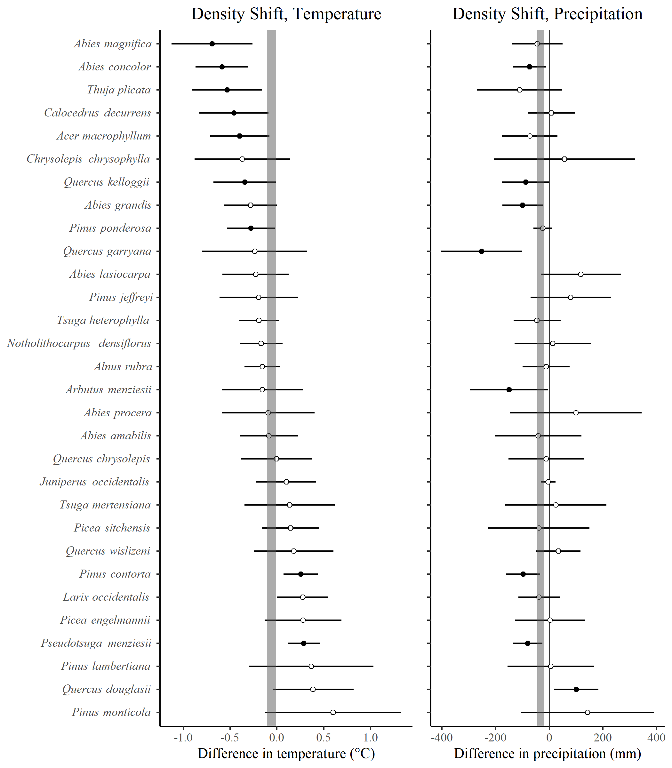
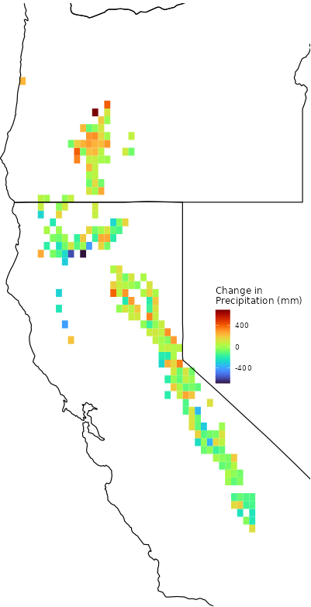
Are tree species’ ranges shifting in west coast USA states? J.D. Groom, M.J. Vicente
Results:
Not much evidence of range shifts associated with temperature or precipitation within the 10-year revisit period.
Densities (figure to right) appeared to shift for some species towards plots that were cooler / drier during the first visit.
Temperatures generally increased across species’ plots, on average.
Precipitation changes were not the same everywhere, and drier first-visit plots often increased in precipitation while wetter plots increased less or decreased.
Check out individual species’ changes here!
https://tinyurl.com/yc8cf4k9/
Change in precipitation for Abies magnifica at FIA plots between the first and second visit. Individual species results like these are available on the analysis dashboard.
Literature Cited:
Bechtold, W.A., Scott, C.T. 2005. The Forest Inventory and Analysis plot design, in: Bechtold, W.A., Patterson, P.L. (Eds.), The Enhanced Forest Inventory and Analysis Program – National Sampling Design and Estimation Procedures. Gen. Tech. Rep. U.S. Dep. Agric. For. Serv. SRS-80.
Daly, C., Halbleib, M., Smith, J.I., Gibson, W.P., Doggett, M.K., Taylor, G.H., Curtis, J., Pasteris, P.P. 2008. Physiographically sensitive mapping of climatological temperature and precipitation across the conterminous United States. Int. J. Climatol. 28, 2031-2064.
Differences in mean plot temperature and precipitation between plots that contained more and fewer trees at the second visit. Means and 95% confidence intervals are shown. Vertical grey bars represent 95% confidence intervals for all plots across species.

